Slide 1

22.3.21
From genes to proteins and back
Marc Vaudel
Center for Medical Genetics and Molecular Medicine, Haukeland University Hospital, Bergen, Norway
Center for Diabetes Research, Department of Clinical Science, University of Bergen, Norway
THREE LEVELS [2015] TYLER HOBBS

Slide 2
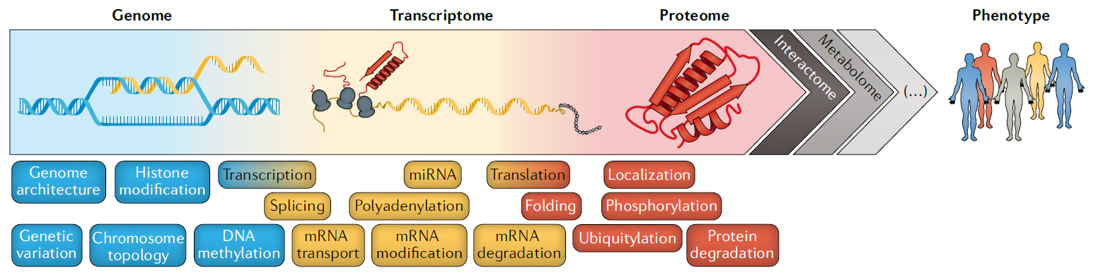
Proteomics is a crossroad
‹#›
Notes:
From doi: 10.1038/s41467-019-09018-y

Slide 3

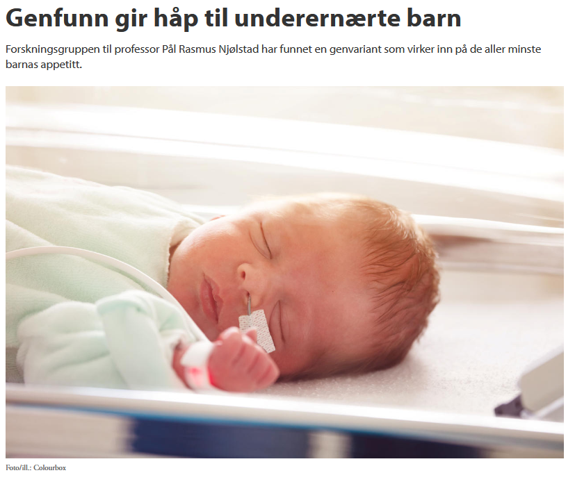
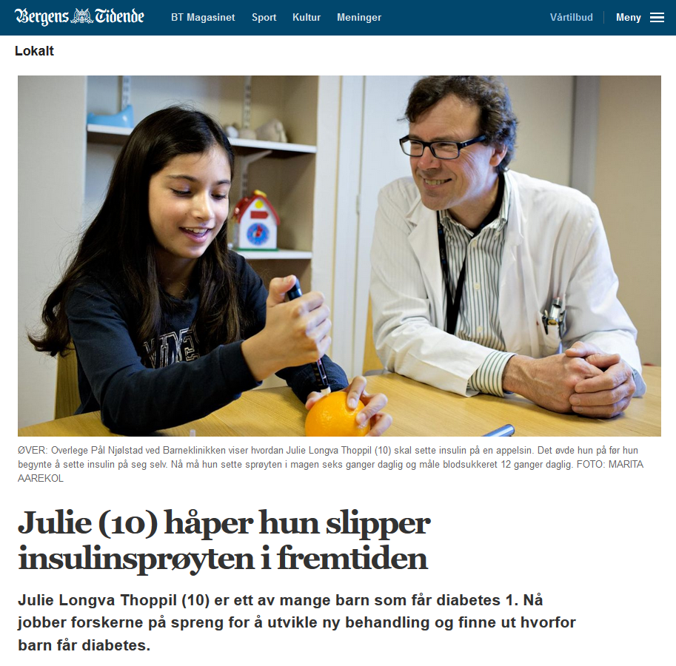
Data Science in pediatric metabolic disorders
What influences the growth of babies?
Can diabetic children avoid insulin shots?
‹#›

Slide 4
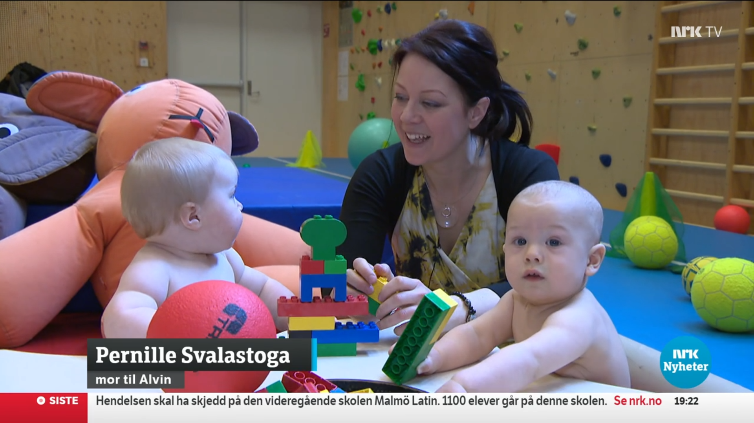
What influences the growth of babies?
‹#›
Notes:
https://tv.nrk.no/se?v=NNFA19032122&t=1312s

Slide 5




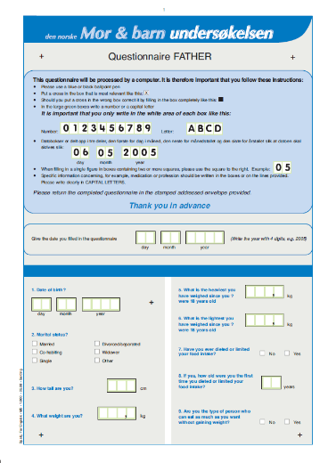
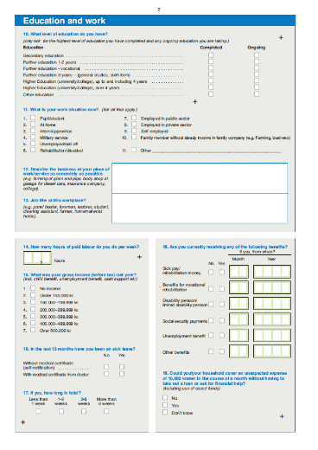

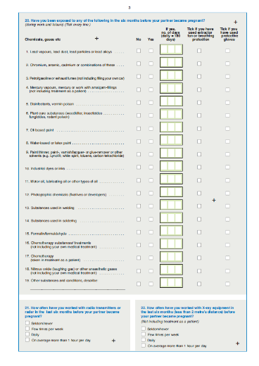
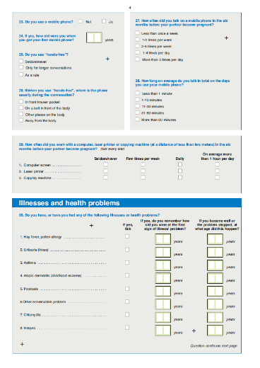
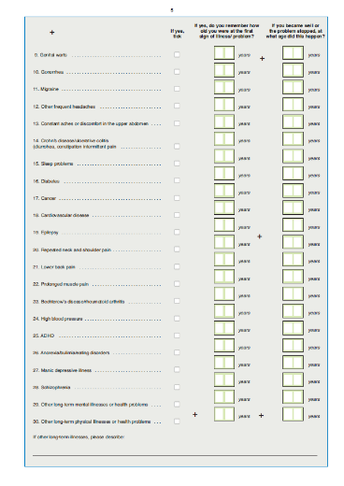

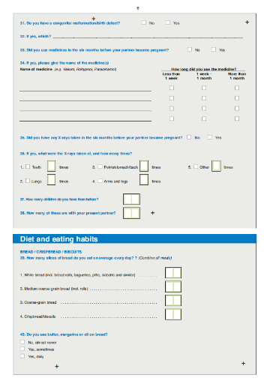
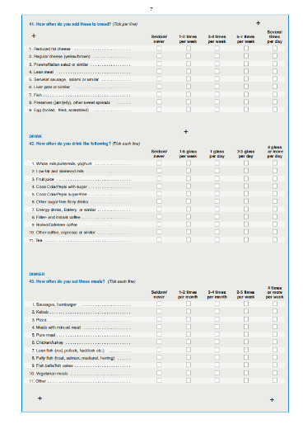
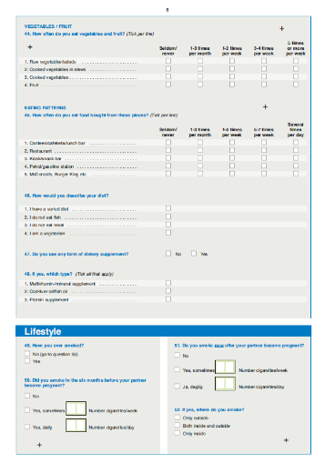
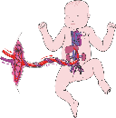
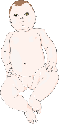

The Norwegian Mother and Child Cohort Study (MoBa)
Children | 114,240
Mothers | 95,229
Fathers | 75,204
Mother
Father
- Age - Weight - Height - Diet - Diseases …
- Age - Weight - Height - Diseases …
Participants | 284,673
Common Genetic Variants | c.a. 9,000,000
Pregnancy
- Duration - Complications - Placenta - Umbilical cord …
Delivery
Baby
Child
Adolescent
- Complications - APGAR - Amniotic Fluid …
- Growth - Breastfeeding - Diseases …
- Growth - Development - Diseases …
- Growth - Puberty - Health …
‹#›

Slide 6




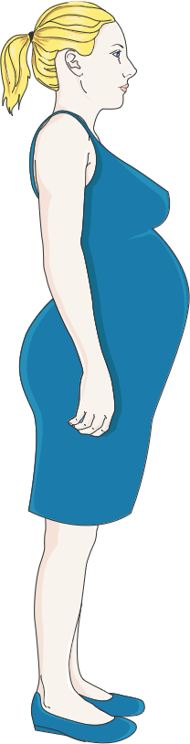
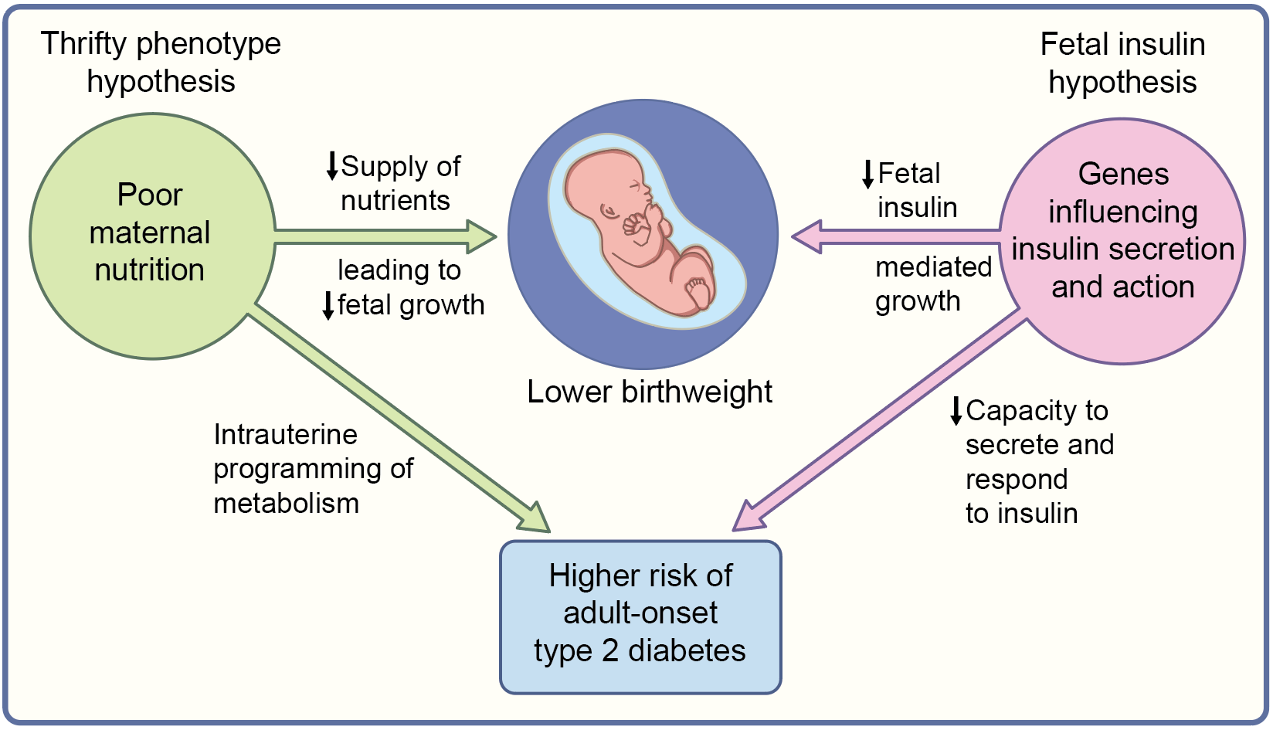

Genetics during pregnancy
Children | 1,500,000
Mothers | 1,100,000
Fathers | 130,000
Participants | 2,730,000
‹#›
Notes:
doi.org/10.1038/s41588-019-0403-1

Slide 7
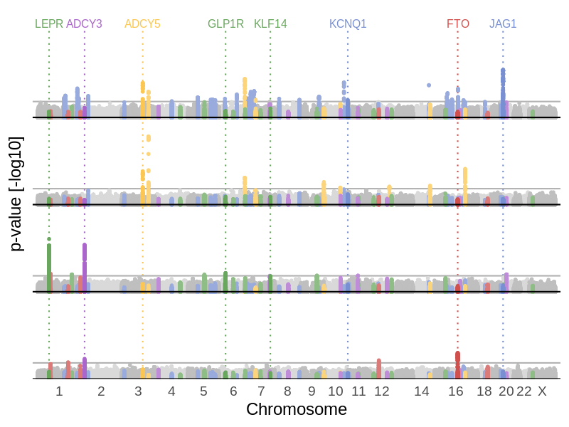
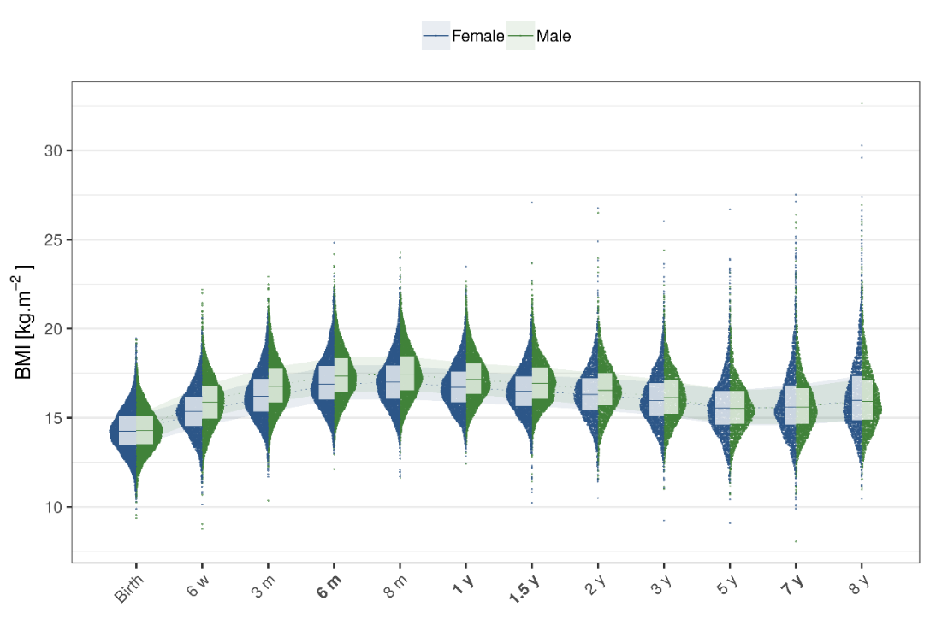
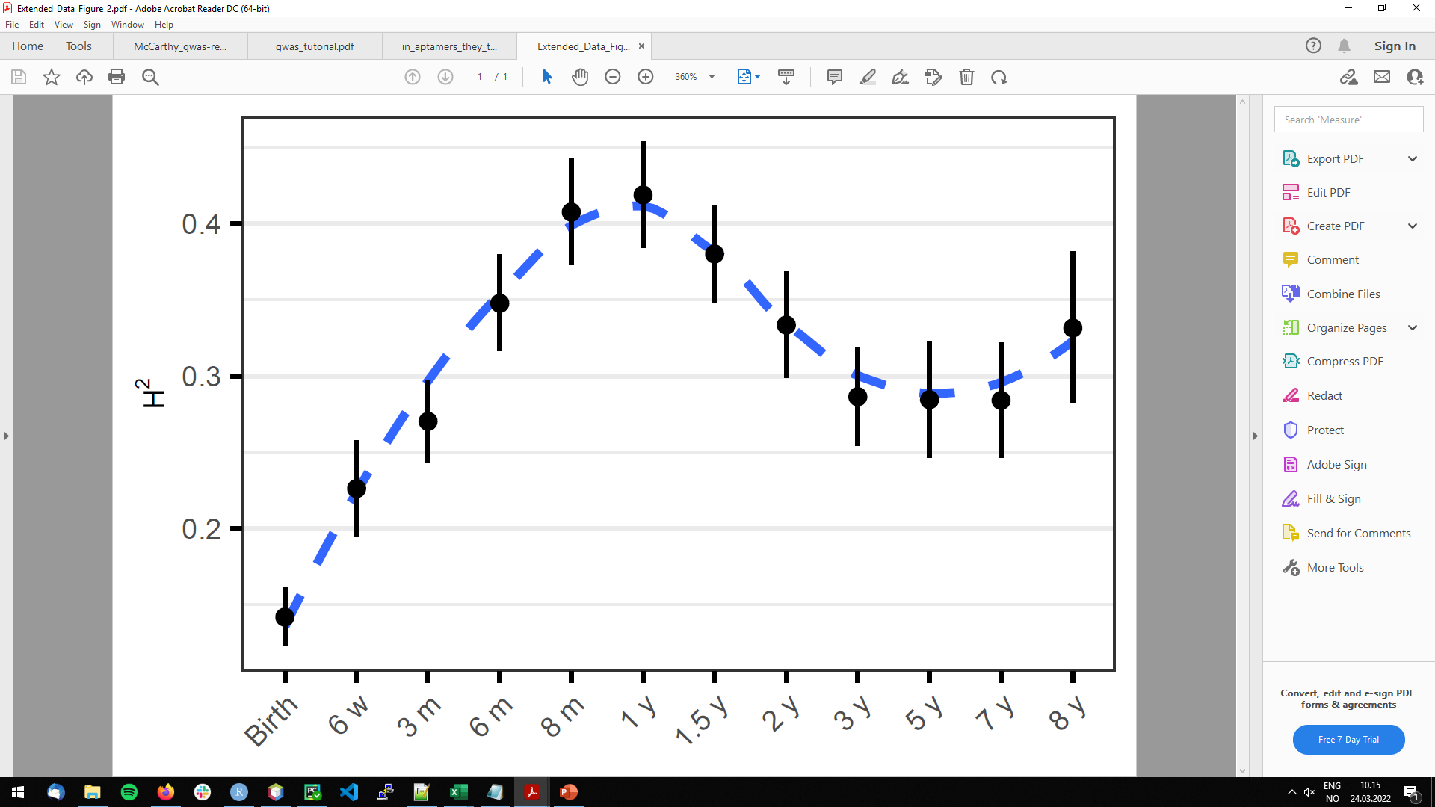
Early Growth
‹#›
Notes:
DOI: 10.1101/2021.05.04.21256508
doi.org/10.1038/s42255-022-00549-1 https://rdcu.be/cJxow

Slide 8
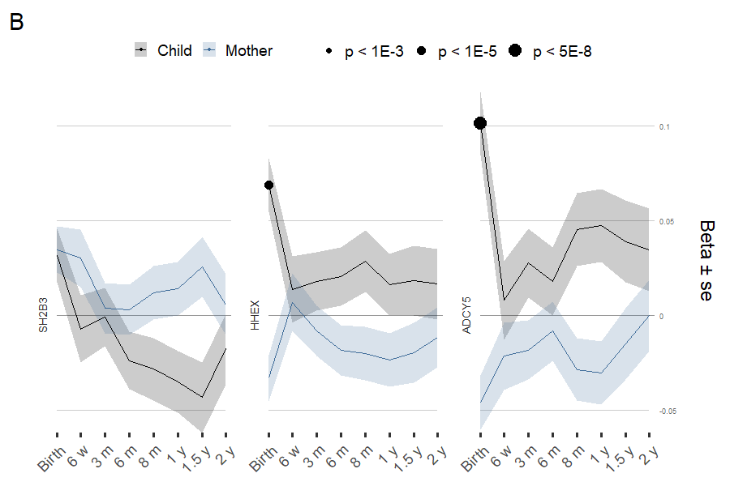
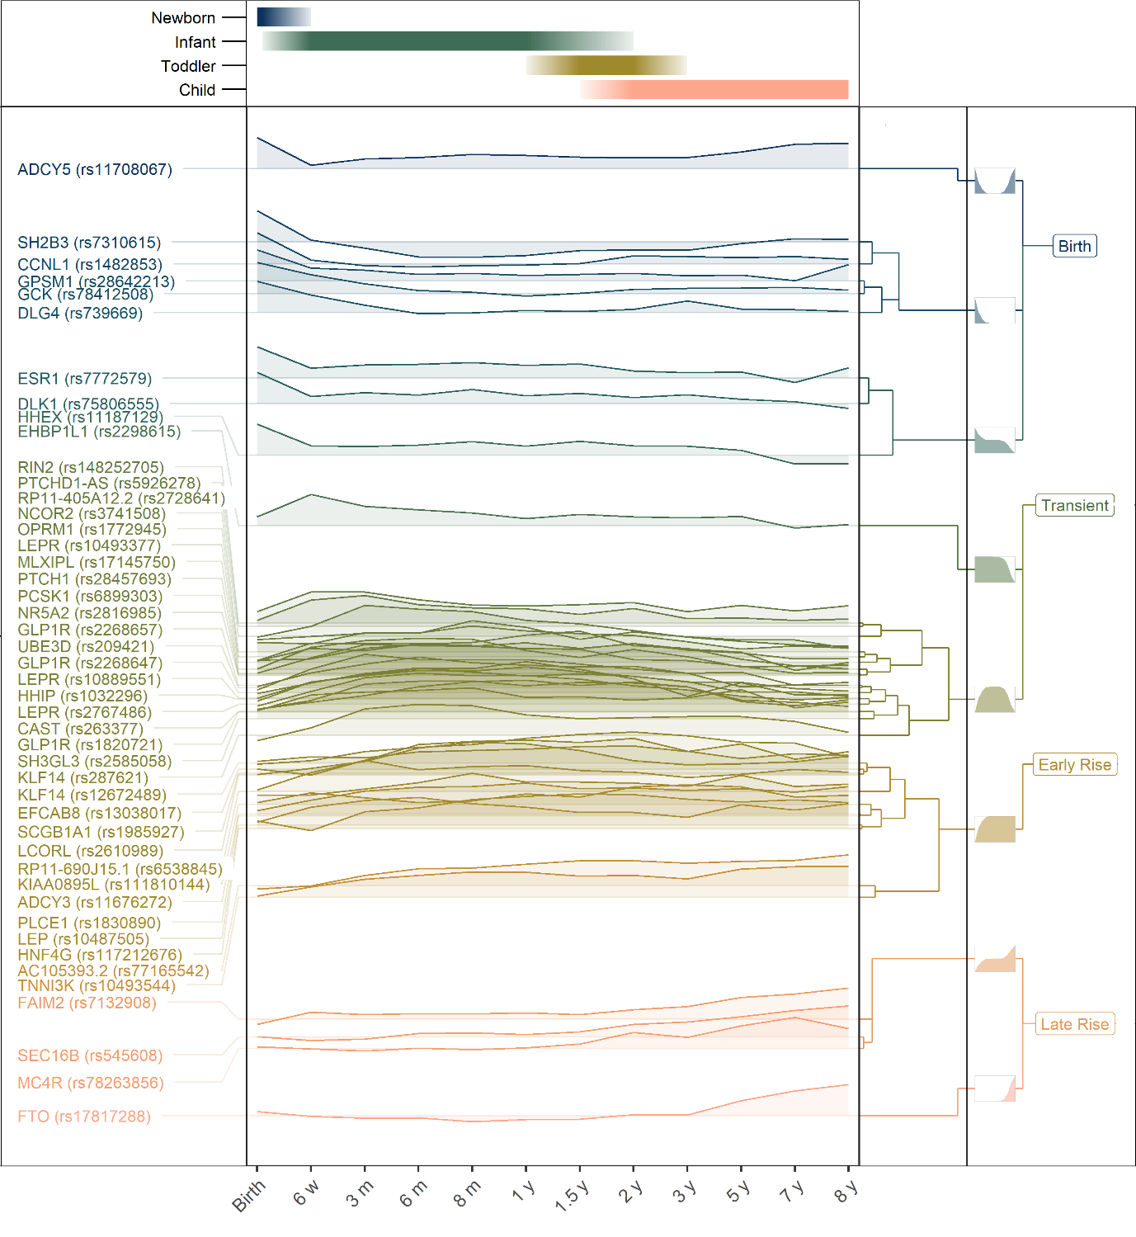
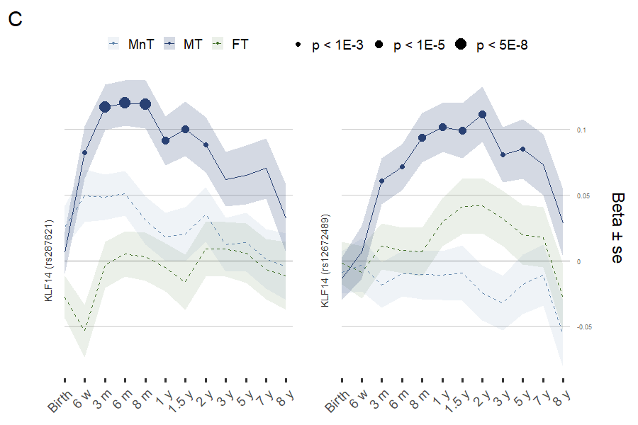
The genetics of early growth
‹#›

Slide 9
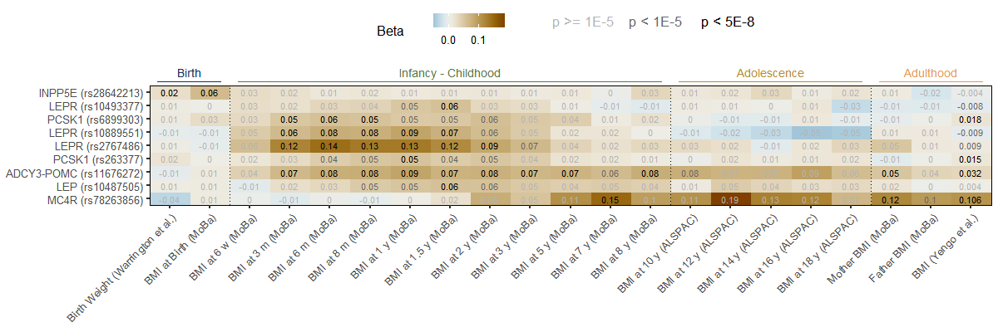
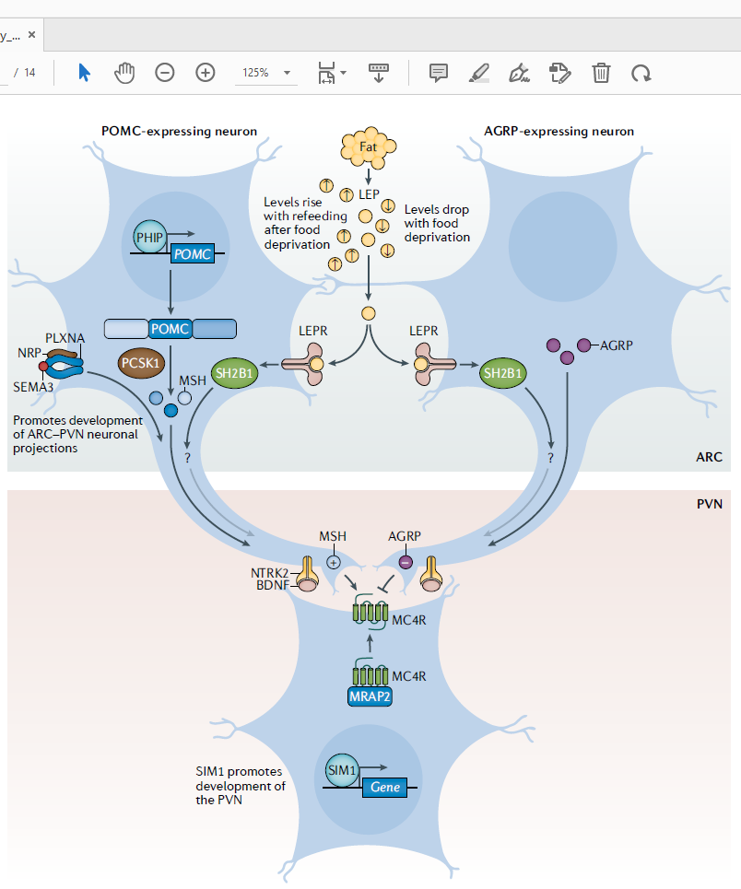
The genetics of early growth
‹#›

Slide 10
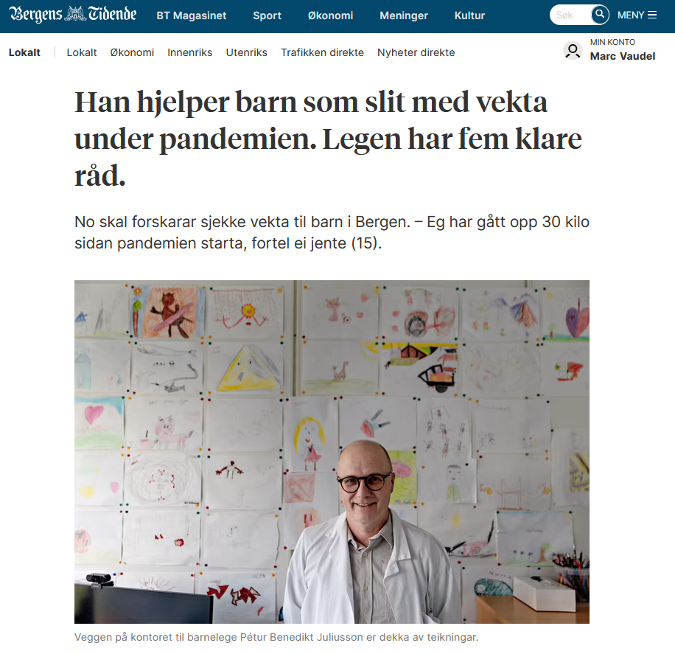
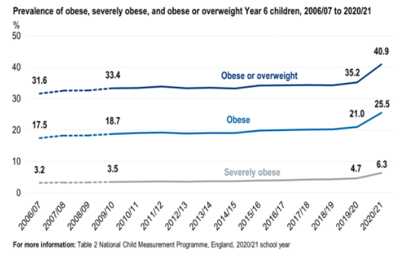
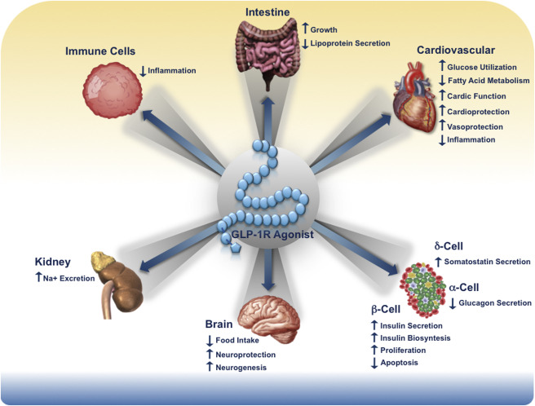
Helping clinical teams better handle metabolic imbalance
‹#›

Slide 11
Data Science in pediatric metabolic disorders
What influences the growth of babies?
Can diabetic children avoid insulin shots?
‹#›

Slide 12
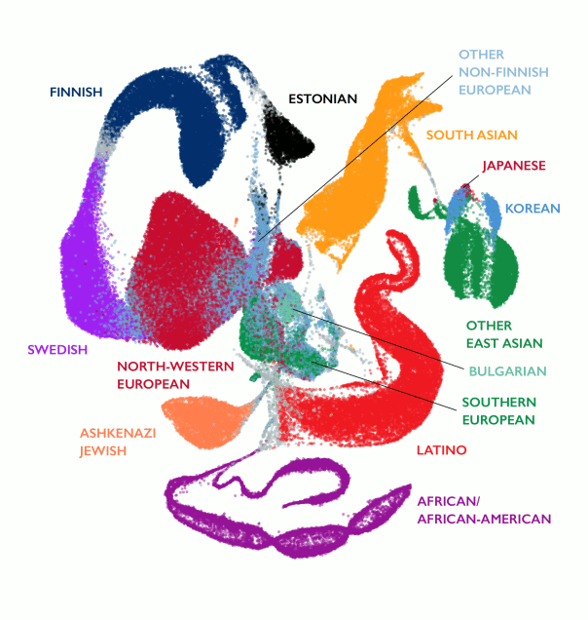
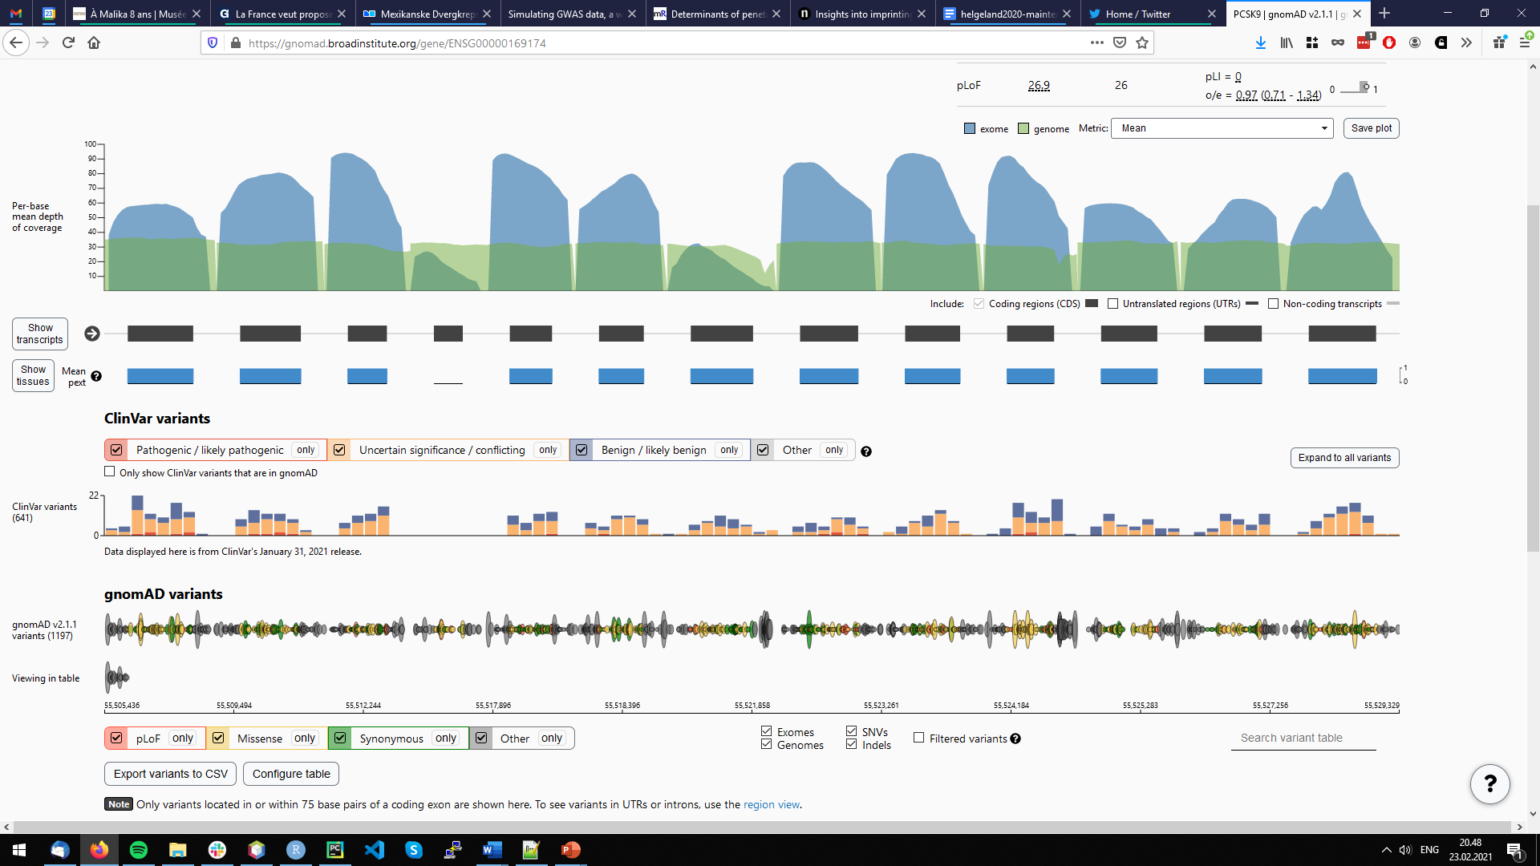
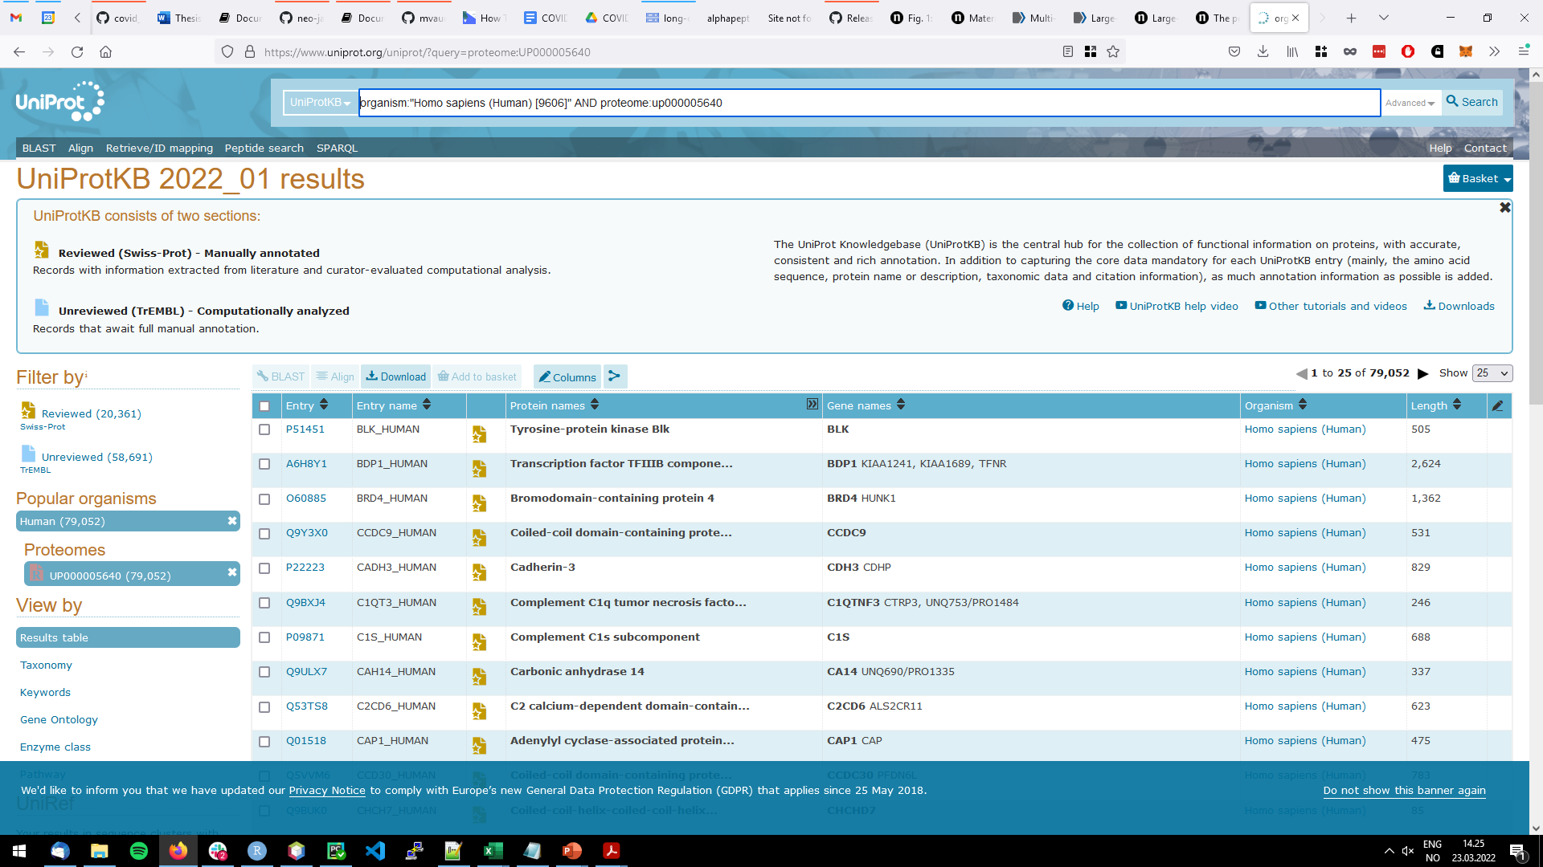
Genomic variation and proteomics
‹#›

Slide 13

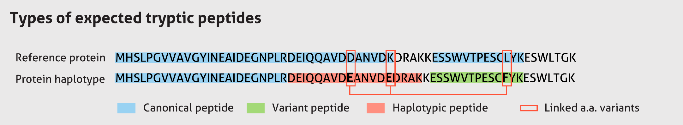
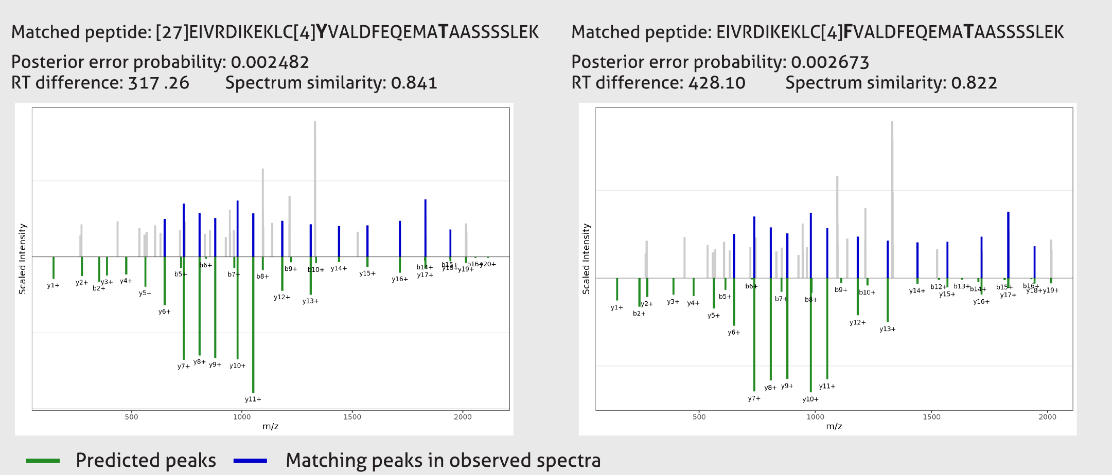
Accounting for haplotypes
‹#›
Notes:
- Haplosaurus: https://doi.org/10.1038/s41467-018-06542-1

Slide 14

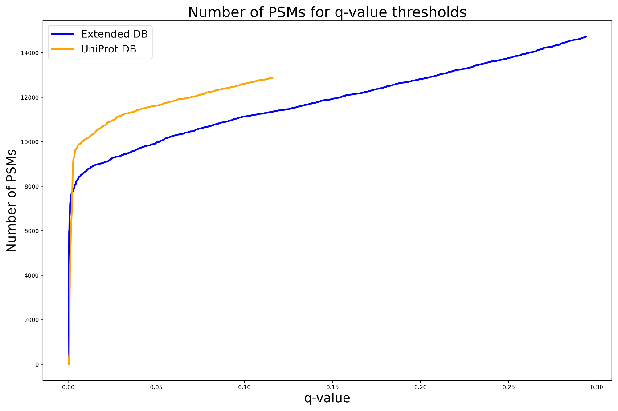
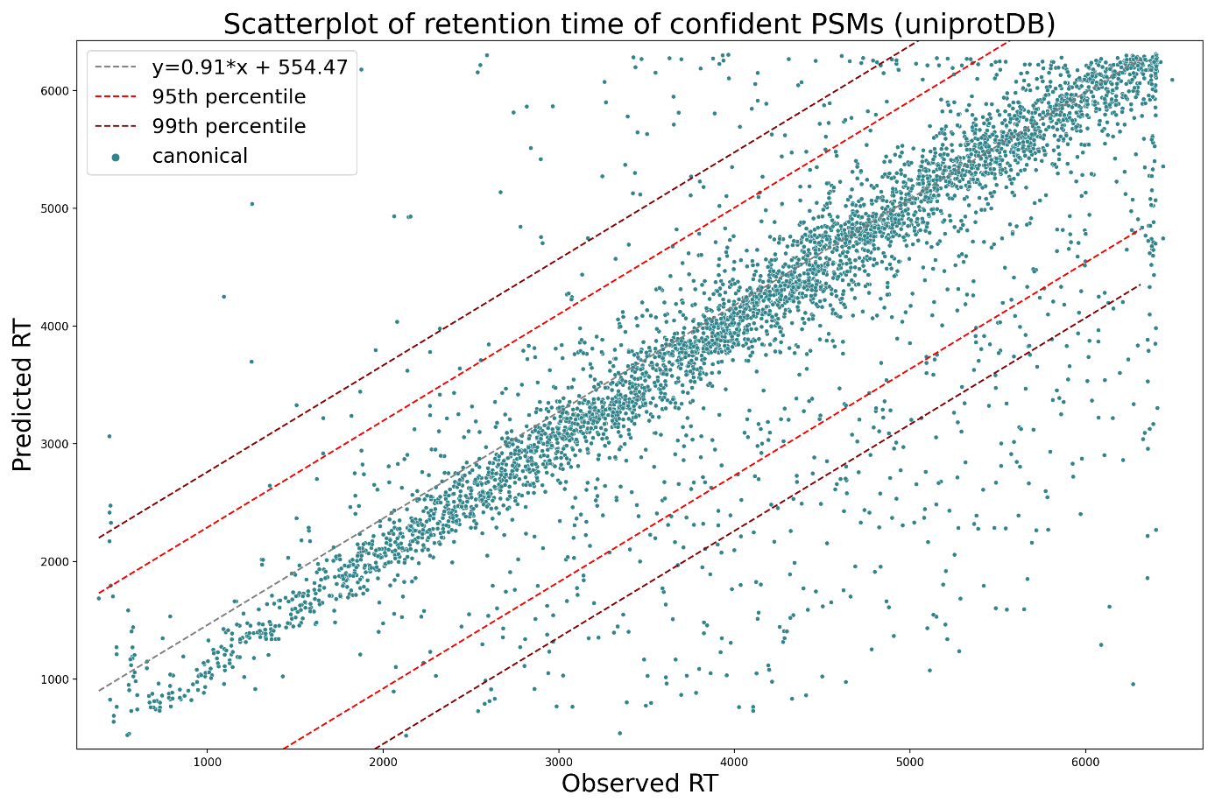
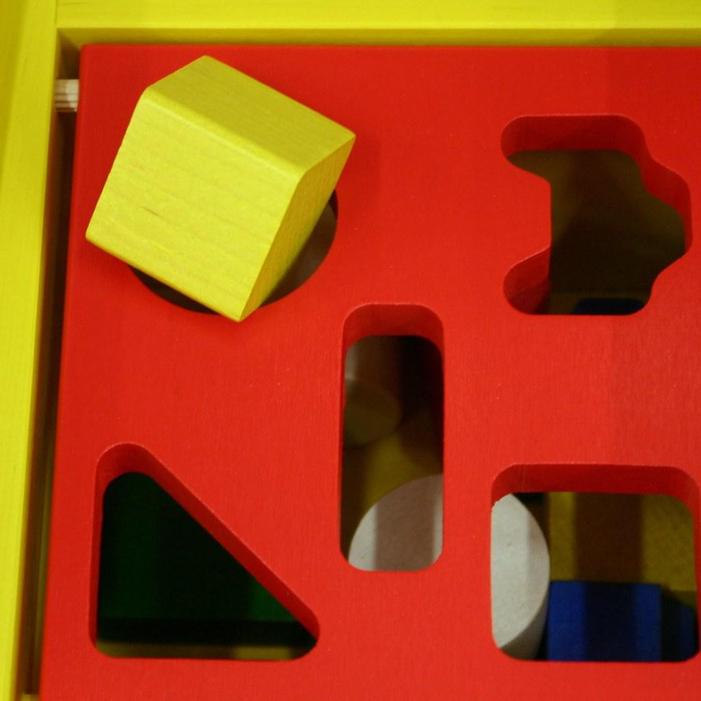
Variant peptides identification
‹#›

Slide 15
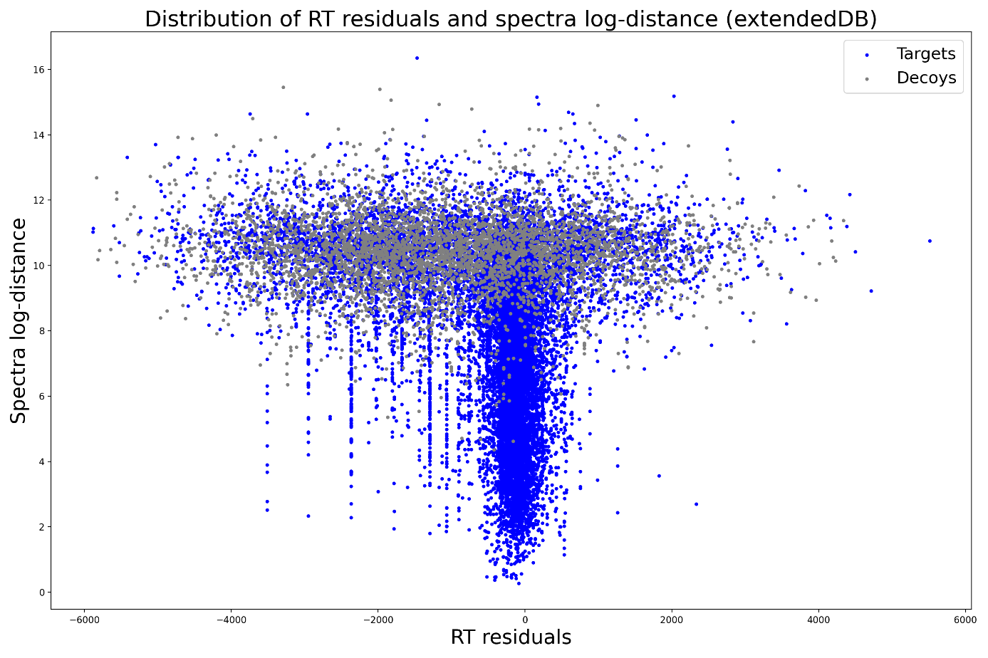
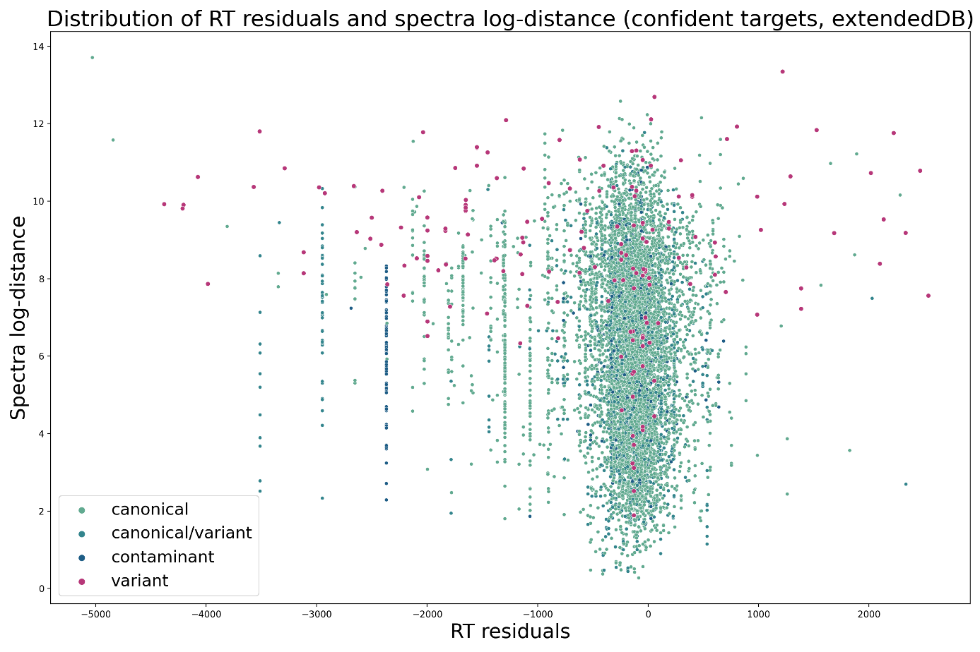
Variant peptides identification
‹#›

Slide 16
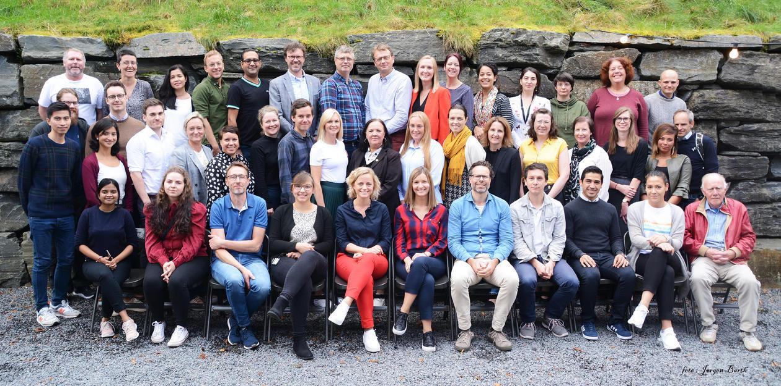



Acknowledgement

Slide 17
How do we cluster, predict, something meaningful?

Slide 18
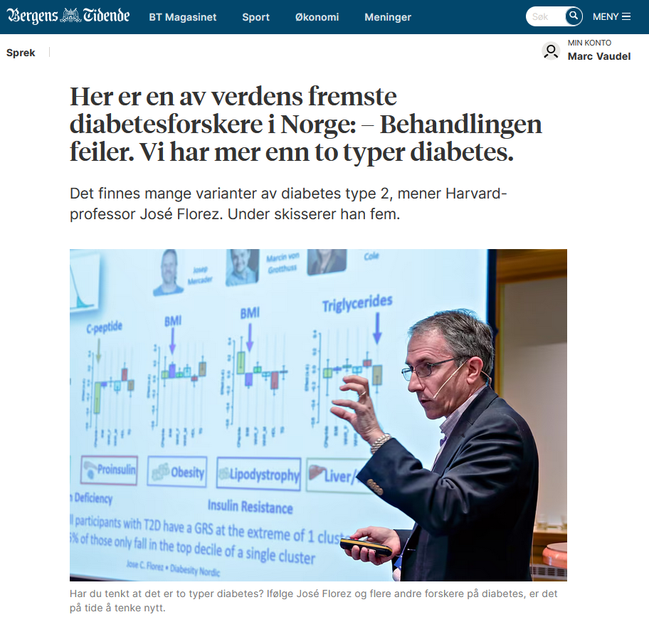
Can your results be reused by others?
# Clustering and prediction:
- reproducible/simple
- interpretable
- actionable
‹#›

Slide 19
What is the place of proteomics in large cohort studies?

Slide 20
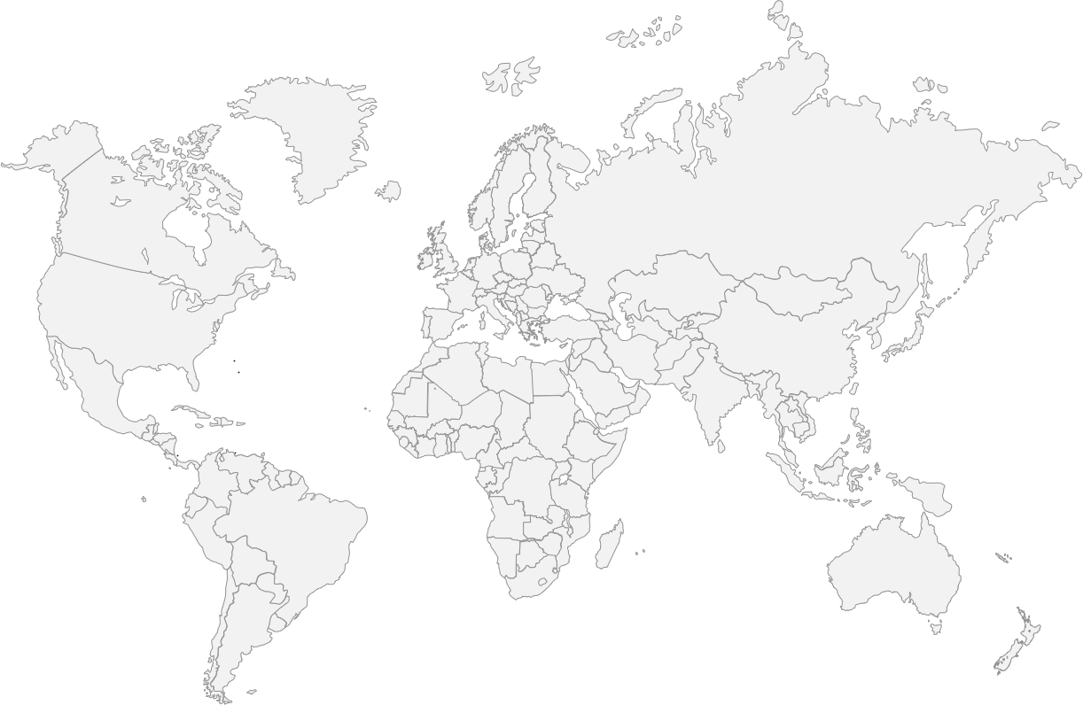
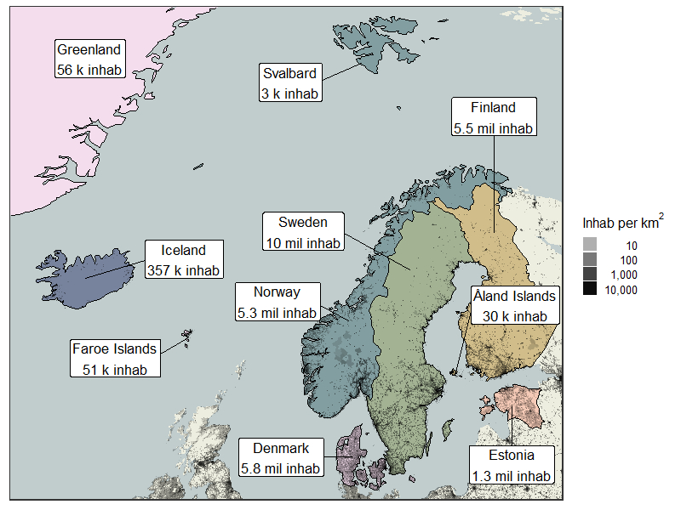
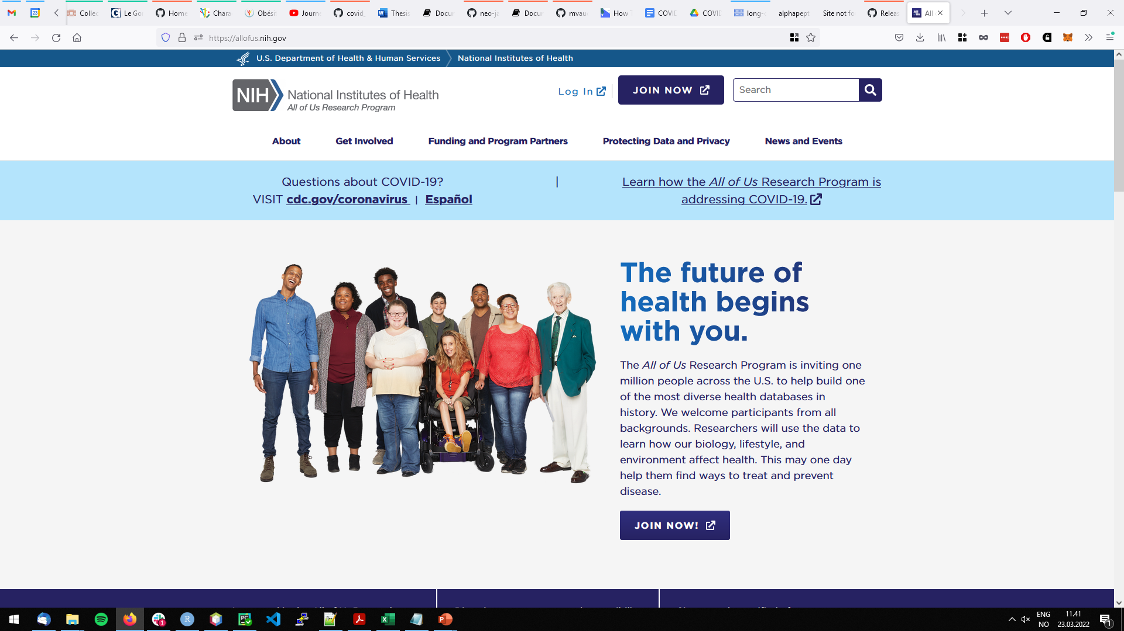
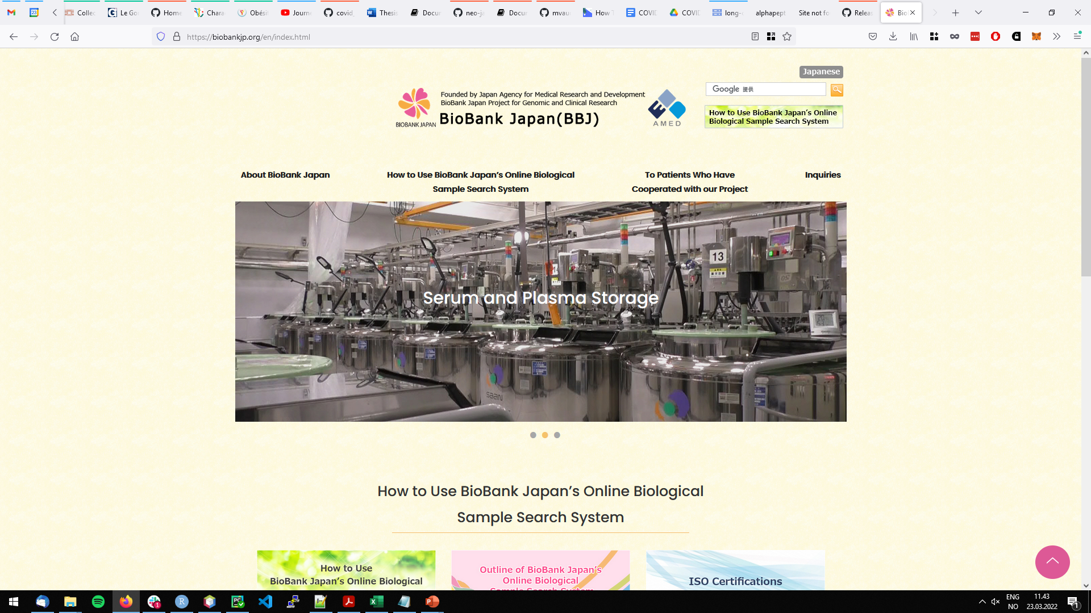
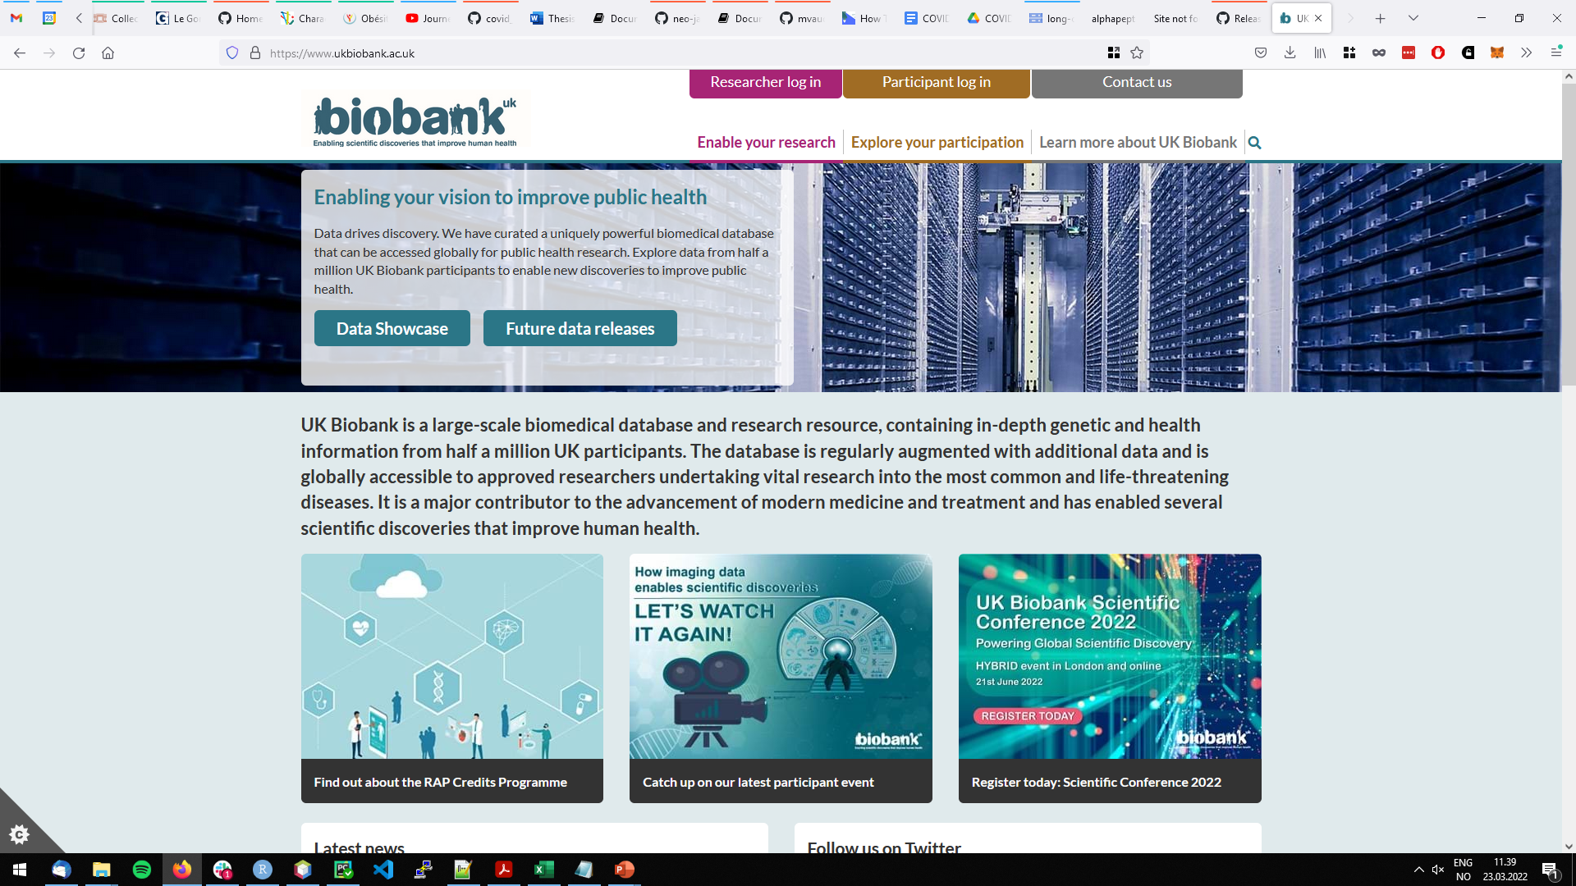
Cohort and registry studies
‹#›

Slide 21
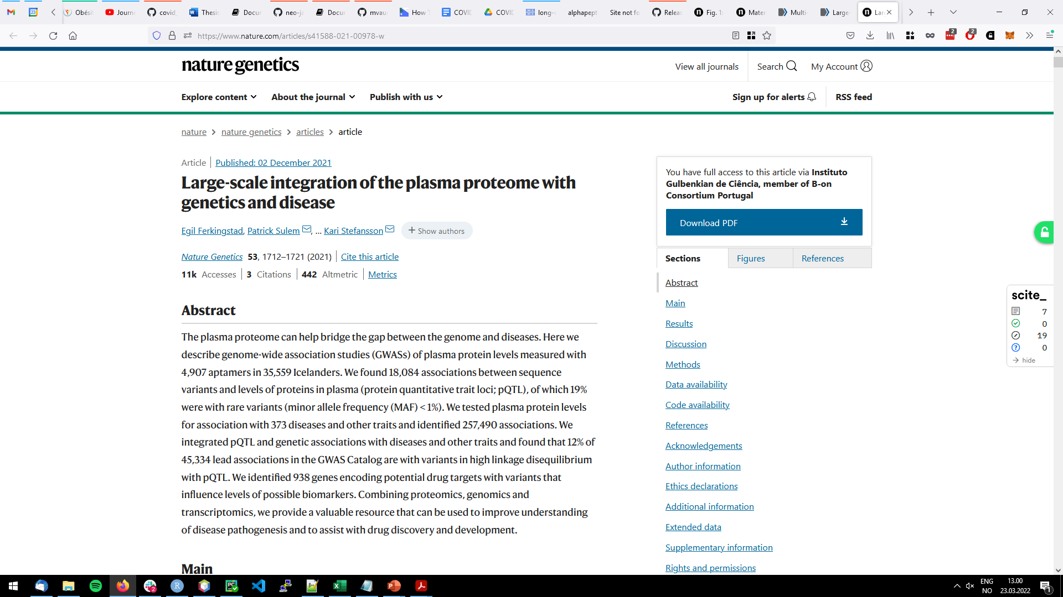



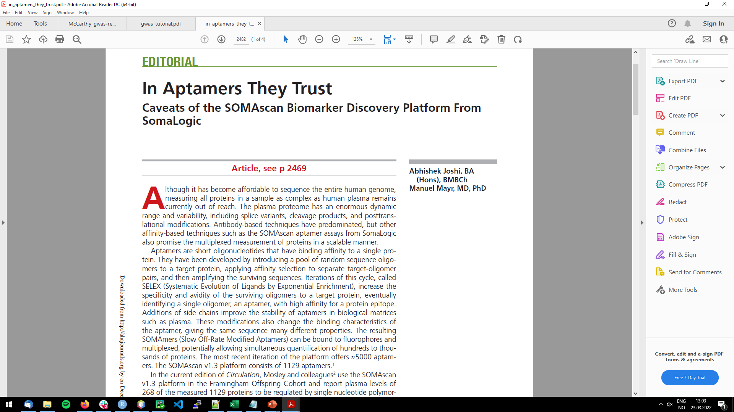
Lage-scale proteomics screens
‹#›

Slide 22
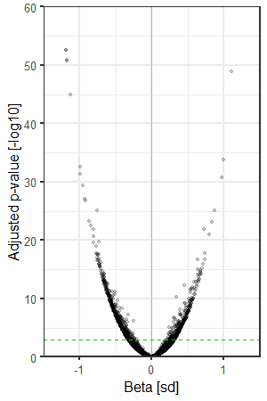
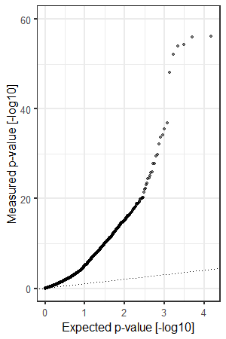
More significant proteins is not always good
N = 300 vs. 300
‹#›

Slide 23
How do we communicate about proteomics?

Slide 24
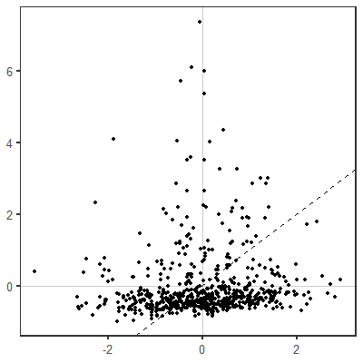
The proteome can be viewed through different prisms
NA
‹#›

Slide 25
Can we contribute to making healthcare research more inclusive?

Slide 26
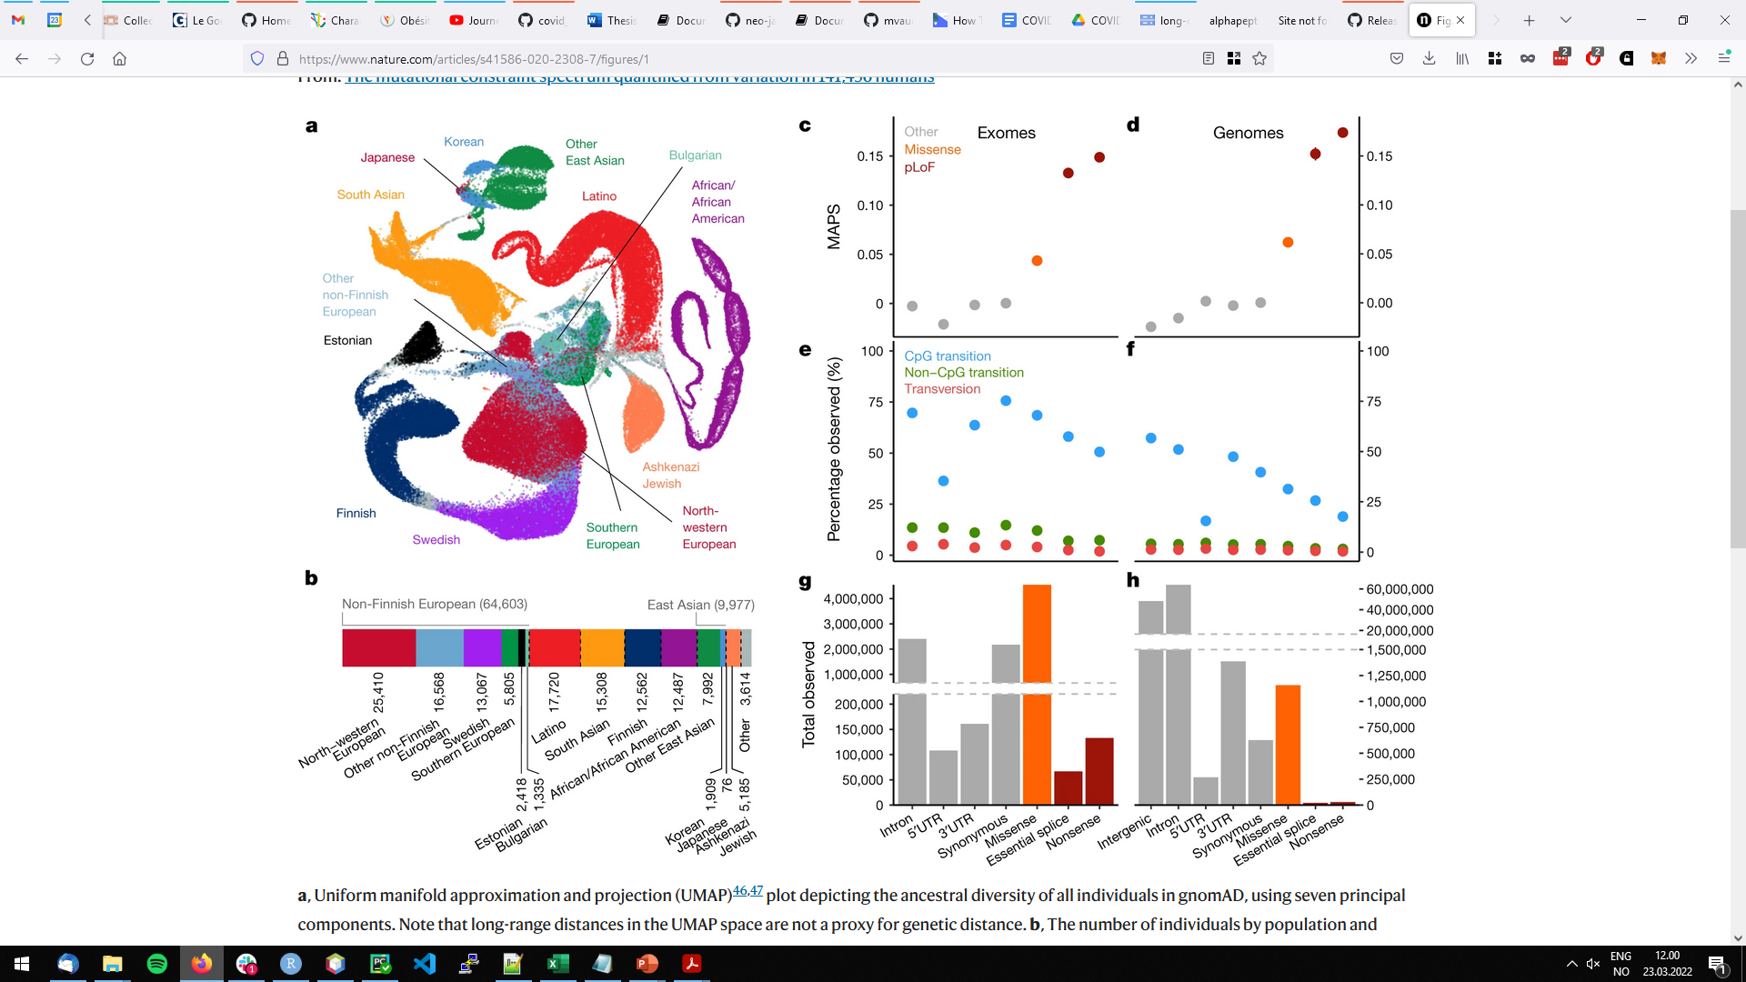
Cohort and registry studies
‹#›

Slide 27
How do we cluster, predict, something meaningful?
What is the place of proteomics in large cohort studies?
How do we communicate about proteomics?
Can we contribute to making healthcare research more inclusive?
‹#›

